Slide 1
COVID-19 Vaccinations trend analysis
Vikas E

Slide 2
Project analysis slide 2
Analysis
Data Exploration
Data Collection
COVID-19 Vaccinations DATA
Data Cleaning
Data Transformation
Data Analysis
Visualizations

Slide 3





Project analysis slide 3
Project Analysis
169
1228 bn
487 bn
672 bn
Vaccinations
The Total of 169 Countries participated in Vaccination.
Total 1228 billion vaccinations are successfully done over the world.
487 billion Peoples are Fully Vaccinated all over the world
672 billion Peoples are Vaccinated 1st dose all over the world.
Covaxin, Sputnik V, Johnson&Johnson and Moderna vaccines are used in the most of the countries.

Slide 4
Project analysis slide 4
Vaccinations statistics
People vaccinated 1st Dose
672 bn
Vaccinations
44 %
People vaccinated 1st Dose
1228 bn
Vaccinations
80 %
Schedules
People Fully vaccinated.
487 bn
Vaccinations
36 %
People Fully vaccinated.
Total Vaccinations
Total vaccinations.

Slide 5
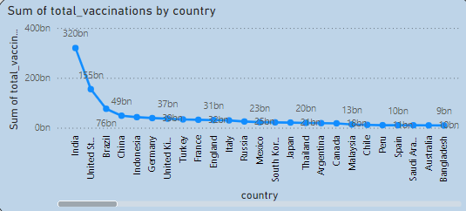
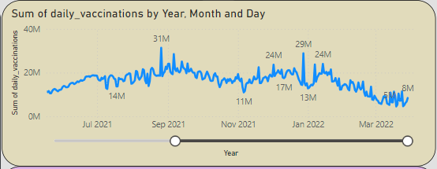
Project analysis slide 5
Project Analysis
India
320 bn
India in the 1st place in total vaccinations by country wise with 320bn vaccinations. • United States holds the next position with 155 billion vaccinations.
August 2021
31 M
In Aug 2021, It was recorded that Highest vaccinations are done in all over the year.

Slide 6
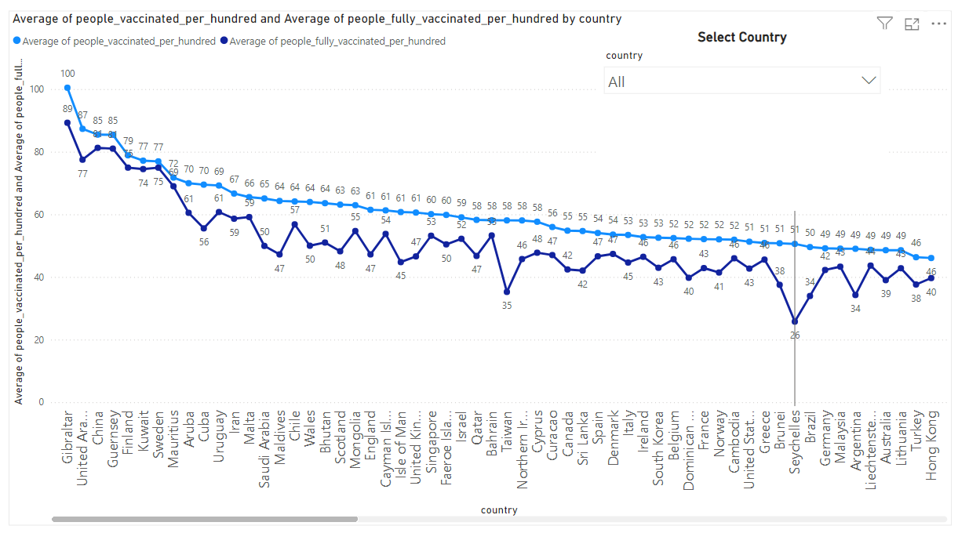
100 %
89 %
Gibraltar country was showed excellent performance responsibly with 89% of fully vaccinated people and 100% vaccinated people. • UAE also participated in vaccination program well.

Slide 7
Thank You

